Slide 1

DHOLE PATIL COLLEGE OF ENGINEERING,PUNE
DEPARTMENT OF COMPUTER ENGINEERING
Presentation On
Library Management System
Presented By –
Guided By -
Prof. Sonal Chanderi
Shivansh Prakash
Shirish Goyal
Yashwant Kawale
Neekil Rathod

Slide 2
Table of contents
Introduction
Literature Survey
Problem Statement
Scope
System Architecture
Advantages & Disadvantages
Project Time and Budget
Conclusion

Slide 3
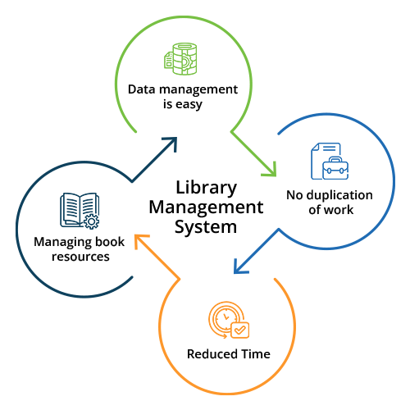
Introduction
The Library Management System is a digital platform designed to streamline and automate various library operations.
It facilitates tasks such as cataloging books, managing memberships, tracking borrowed items, and generating reports.
By leveraging web technologies like HTML, CSS, and JavaScript, the system aims to enhance accessibility, efficiency, and user experience within libraries.
LMS enables librarians to automate manual processes, track inventory, manage memberships, and provide seamless access to resources for patrons, thereby enhancing overall library efficiency and user satisfaction.

Slide 4
Literature Survey
Sr.No. | Name of Paper | Year of paper Published | Author | Summary
1. | Designing User Interfaces for Library Management Systems with HTML, CSS, and JavaScript | 2020 | Alice Johnson, Bob Smith | This paper explores the design principles and techniques for creating user interfaces for library management systems using HTML, CSS, and JavaScript. It discusses best practices for layout, navigation, and interactivity, with a focus on optimizing the user experience for library patrons and staff.
2. | Styling Library Catalogs: A Guide to CSS Customization | 2018 | Sarah Miller, Michael Johnson | This guidebook offers practical tips and examples for customizing the visual appearance of library catalogs using CSS. It covers topics such as typography, color schemes, layout customization, and responsive design, enabling libraries to create unique and visually appealing catalog interfaces tailored to their needs.

Slide 5
Problem Statement
Outdated Systems: Many libraries still rely on outdated, manual paper-based systems for cataloging, tracking, and managing library resources.
Inefficient Processes: Traditional library management systems often involve time-consuming manual tasks such as book checkout, return, and inventory management, leading to inefficiencies and delays.
Limited Accessibility: Accessibility to library resources may be restricted by physical location and operating hours, hindering user convenience and satisfaction.
Data Security Concerns: Paper-based systems lack robust security measures, making library records vulnerable to loss, theft, or unauthorized access, posing risks to user privacy and data integrity.

Slide 6
Scope
Digital Catalog Management: Develop a user-friendly interface for browsing and searching library resources, including books, journals, and multimedia materials.
User Authentication and Management: Implement secure user authentication mechanisms to manage library memberships, including registration, login, and profile management.
Borrowing and Return System: Create a system for users to borrow and return library materials electronically, with features for managing due dates, renewals, and overdue fines.
Reporting and Analytics: Incorporate reporting and analytics functionalities to track library usage, circulation statistics, popular resources, and user preferences, enabling data-driven decision-making.
Administrative Tools: Provide administrative tools for librarians to manage library collections, conduct inventory audits and generate reports.

Slide 7
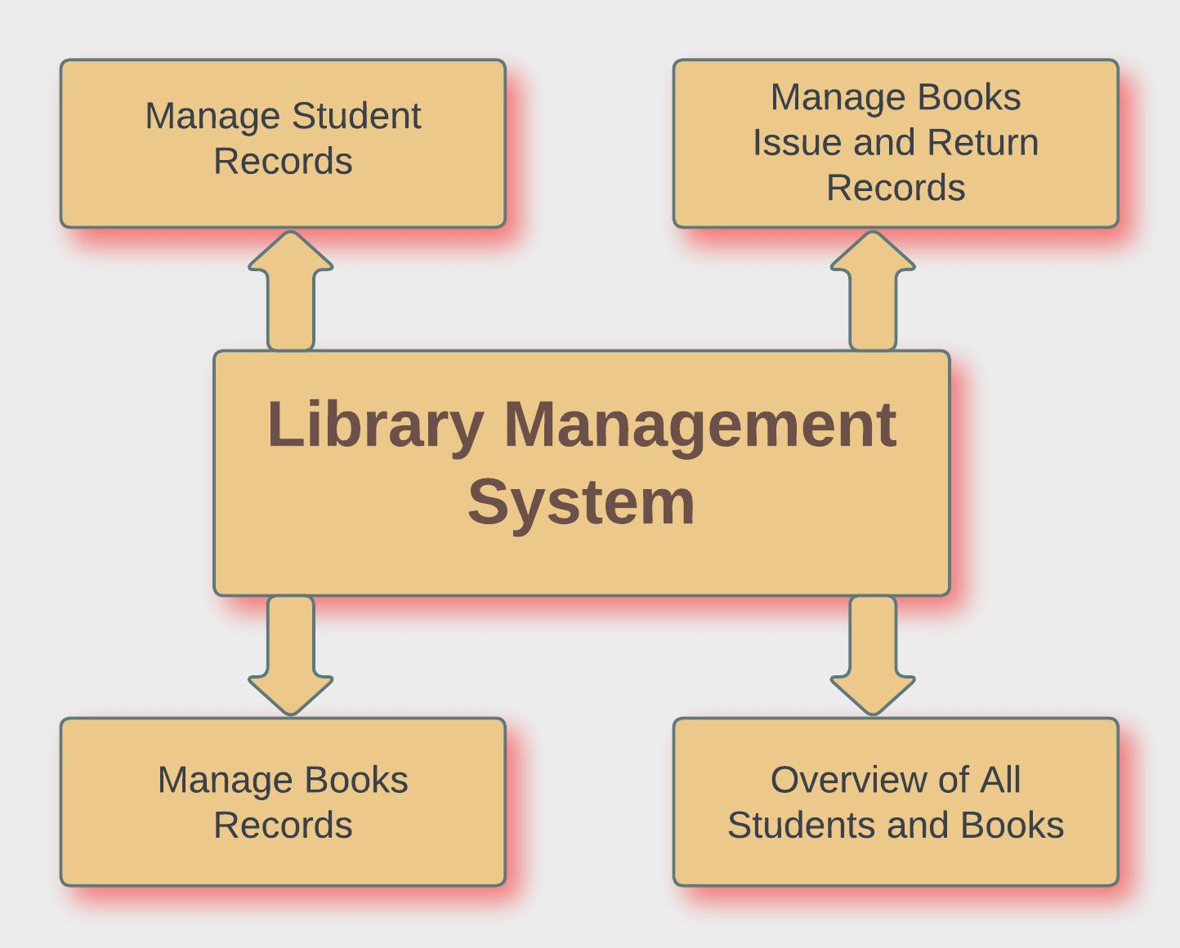
System Architecture

Slide 8
System Architecture
1.Frontend: Utilizes HTML, CSS, and JavaScript to create a responsive interface for administrators and users, facilitating tasks like adding students/books and managing records/reports.
2.Backend: Powered by PHP and SQL (MySQL) for server-side logic, data management, and database interaction, ensuring robust CRUD operations, authentication, and authorization.
3.Database Management: MySQL manages library data with a schema accommodating books, students, circulation records, and user accounts, focusing on data integrity and preventing duplicates.
4.Integration and Testing: Seamless integration between frontend and backend components ensures smooth communication. Testing involves user input validation, data integrity verification, and end-to-end tests for bug identification and resolution.
5.Overall Efficiency: This architecture provides a structured approach, ensuring efficiency, scalability, and reliability in managing library resources and administrative tasks while maintaining data integrity and security.

Slide 9
Advantages
Efficient Resource Management: Facilitates easy cataloging, organization, and management of library resources, optimizing resource utilization.
Simplified Administrative Tasks: Automates administrative tasks such as inventory management, circulation tracking, and reporting, reducing workload and errors.
Improved Decision-making: Provides comprehensive data and analytics tools to track library usage, identify trends, and make informed decisions.
Enhanced Security Controls: Implements robust security measures to protect sensitive library data and ensure compliance with privacy regulations.
Remote Access and Control: Enables administrators to manage library operations from any location with internet access, enhancing flexibility and convenience.

Slide 10
Disadvantages
Initial Implementation Costs: Setting up a Library Management System may require significant investment in software, hardware, and training, posing financial challenges for smaller libraries.
Technical Complexity: Implementing and maintaining the system may require technical expertise, which could be a barrier for libraries with limited IT resources.
Data Security Risks: Storing sensitive library data electronically increases the risk of data breaches, cyberattacks, and unauthorized access, compromising user privacy and confidentiality.
Limited Accessibility: Inadequate internet connectivity or lack of digital literacy among users may restrict access to library resources for certain demographics or communities.
Maintenance and Upkeep: Regular maintenance, updates, and troubleshooting are essential to ensure the smooth functioning of the system, requiring ongoing investments of time and resources.

Slide 11
Conclusion
Improved Efficiency: The Library Management System offers librarians and administrators a powerful tool to streamline operations, reduce manual effort, and enhance resource management efficiency.
Enhanced Decision-making: By providing access to comprehensive data and analytics, the system empowers administrators to make informed decisions, optimize library services, and better meet the needs of patrons.
Better User Experience: While primarily designed for administrators, the benefits of the system ultimately trickle down to users through improved service quality, accessibility, and resource availability.
Future Growth and Innovation: As libraries continue to evolve in the digital age, investing in modern library management systems lays the foundation for future growth, innovation, and adaptation to changing needs and technologies.

Slide 12
ThankYou

